Slide 1

追踪算法研究及在足球视频分析的应用
Tracking Algorithm and Application in Football Match
答辩人：宋嘉菲
指导老师：高盛华

Slide 2
01
01 Background
02 Related works
03 Challenges and contributions
04 Framework
05 Result
06 Further work
目录
CONTENT

Slide 3

Background

Slide 4
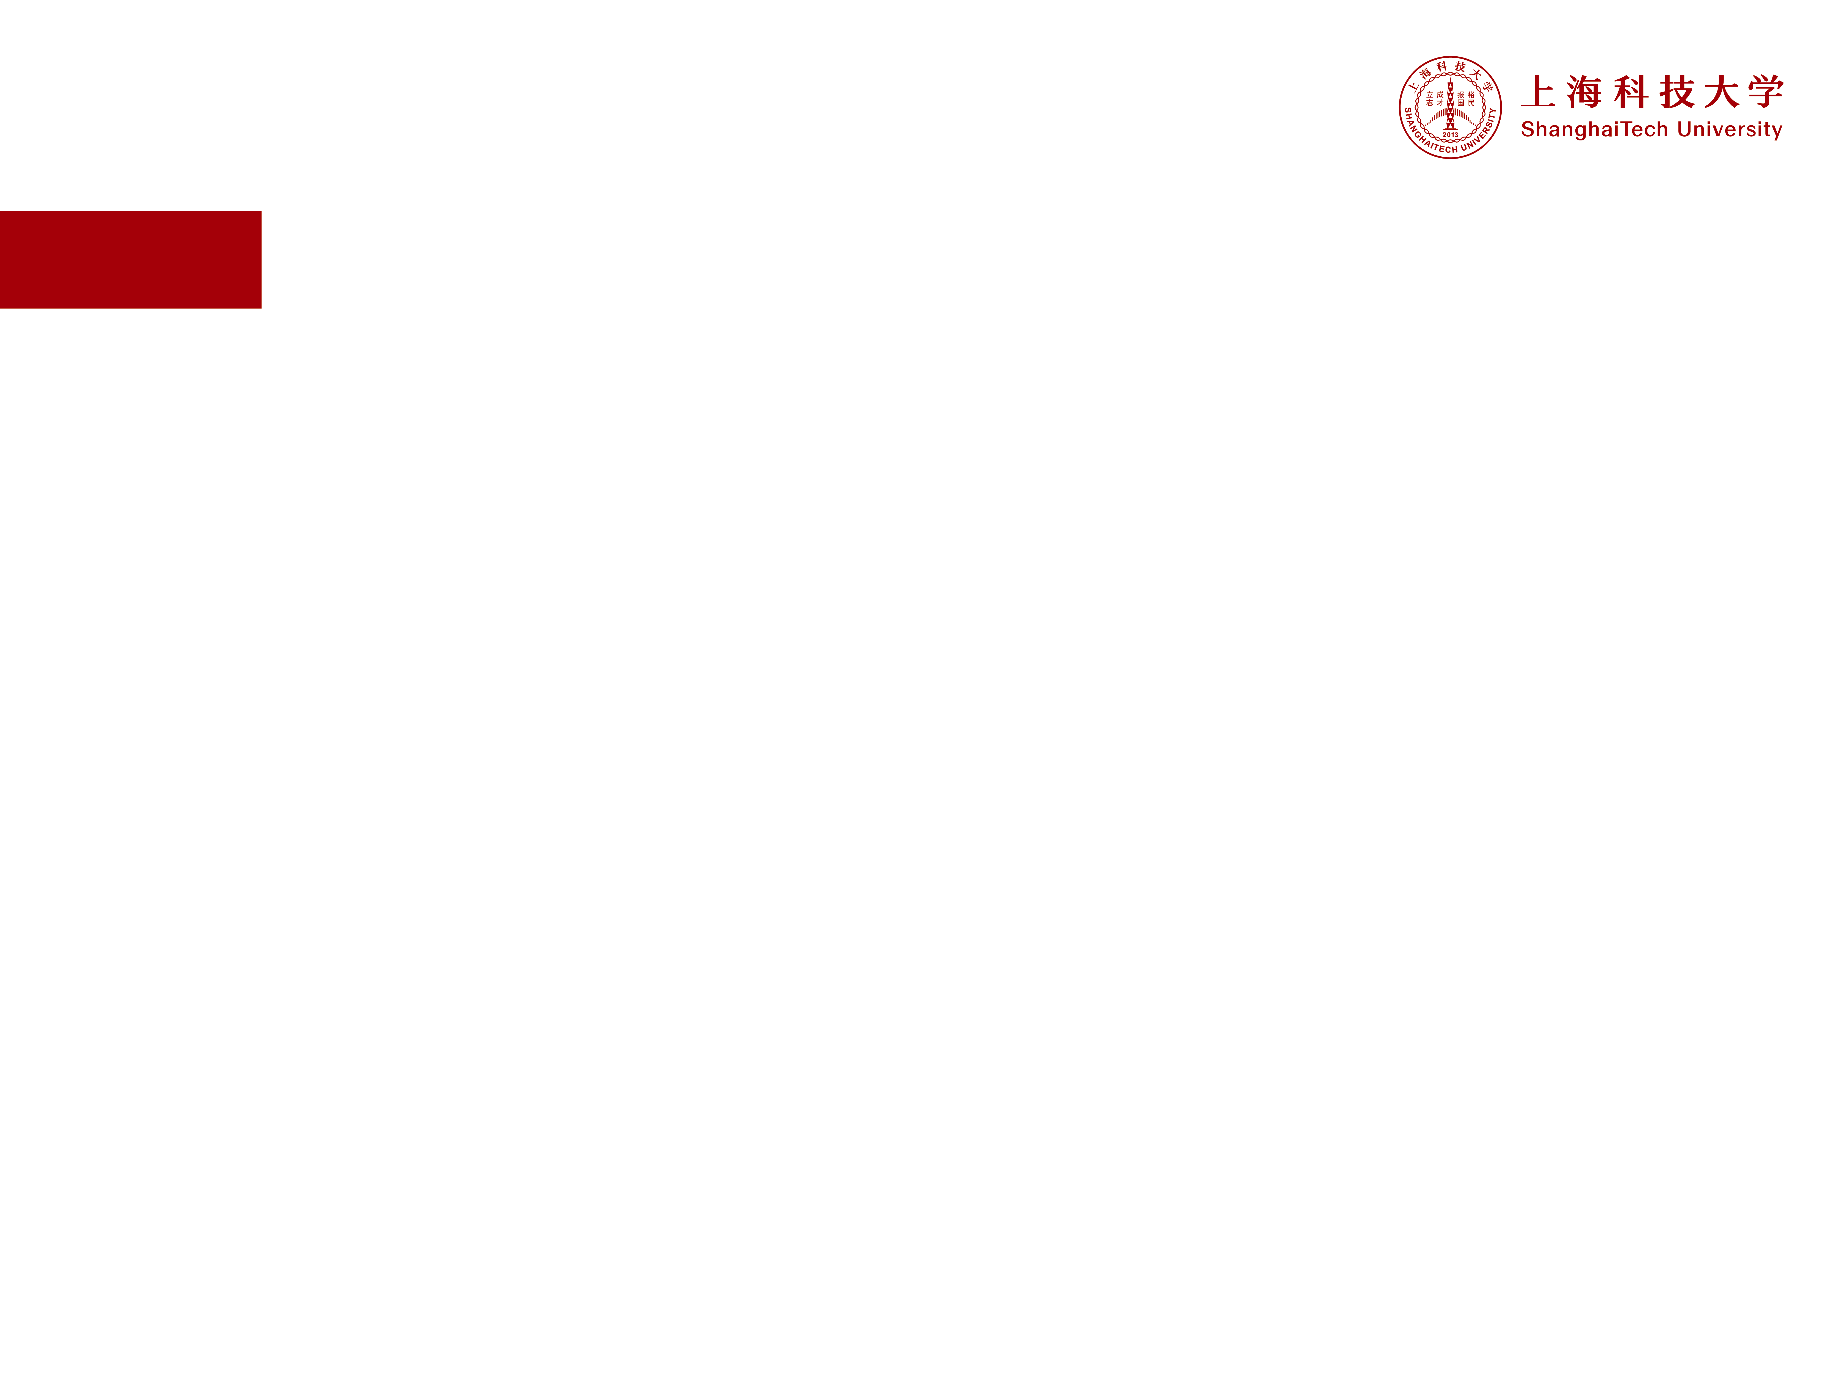
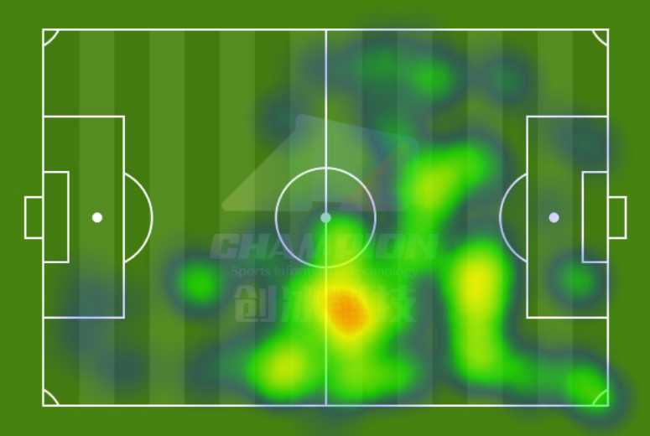
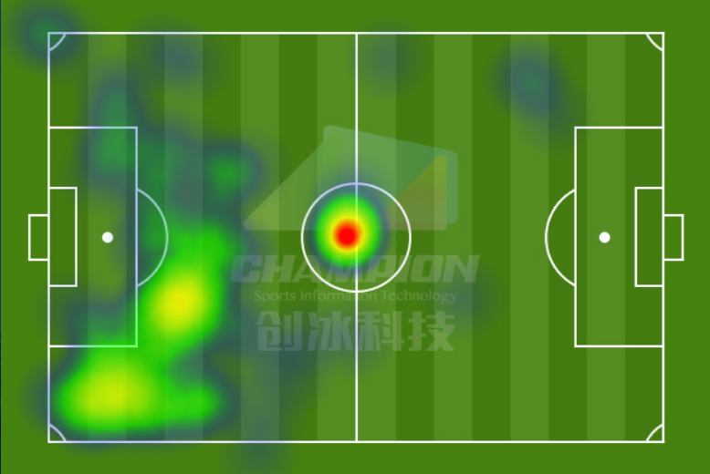
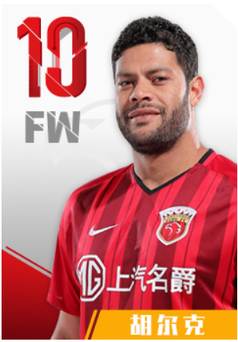
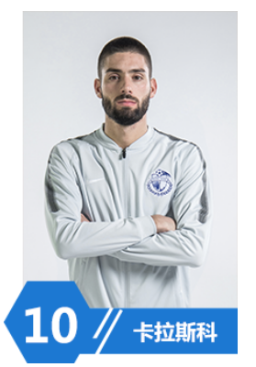


01
Background
Data from
创冰科技
8:0
Notes:
在足球视频中，分析球员跑动轨迹对于战术的执行以及球员的执行力判断有重要的意义。
左边球队8:0 战胜了右边的球队，这是双方前锋跑动热度图的对比。
左边球员覆盖面广，右边球员的跑动最热区在中圈，这也是因为他八次中圈开球的原因。
实力差距可想而知。
分析球员数据十分重要，但如何得到数据呐，这也是依赖于科技的进步。

Slide 5

Related Works
Notes:
接下来我将要介绍一下这方面的相关工作

Slide 6
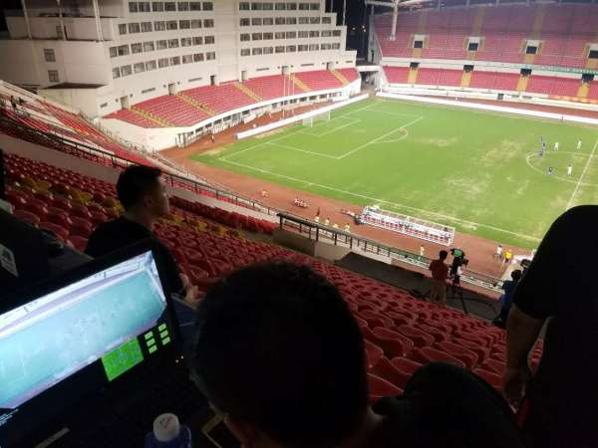
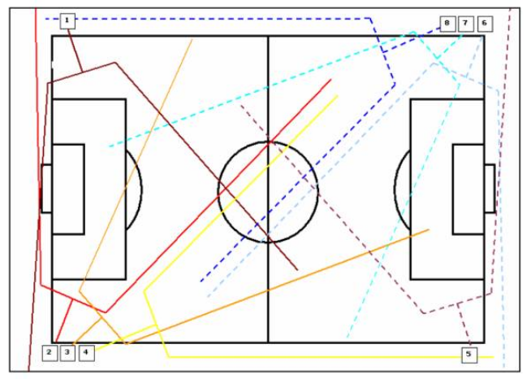
02
Related Works
Football Video Analysis
Camera replacement at
Old Trafford’s and Reebook Stadiums
创冰科技
Notes:
首先是 关于足球视频采集分析的：

Slide 7
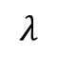
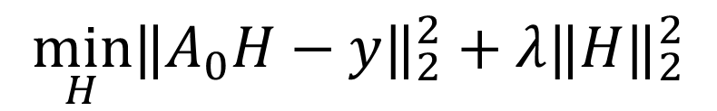
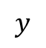
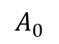
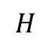
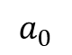
02
Related Works
Single Object Tracking
KCF/DCF: João F. Henriques, Rui Caseiro, Pedro Martins, Jorge Batista. "High-Speed Tracking with Kernelized Correlation Filters." TPAMI (2015).
MOSSE: David S. Bolme, J. Ross Beveridge, Bruce A. Draper, Yui Man Lui. "Visual Object Tracking using Adaptive
Correlation Filters." ICCV (2010).
$$\min_{H}{‖A_{0}H−y‖}_{2}^{2}+λ{‖H‖}_{2}^{2}$$
$$a_{0}$$
Dense sampling by circulantly shifting the object patch
Efficient ridge solution in the Fourier domain
is the learned correlation filter
contain all circulant shifts of patch
is the regression target(image of a 2D Gaussian)
regularization parameters
$$H$$
$$A_{0}$$
$$y$$
$$λ$$

Slide 8

Challenges and Contributions

Slide 9
03
Challenges and Contributions
For application in school football team
Getting data videos by myself
For the limitation of site and occlusion
CF based tracking algorithm
For better analysis
Easy-use of the system and high speed

Slide 10

Framework

Slide 11
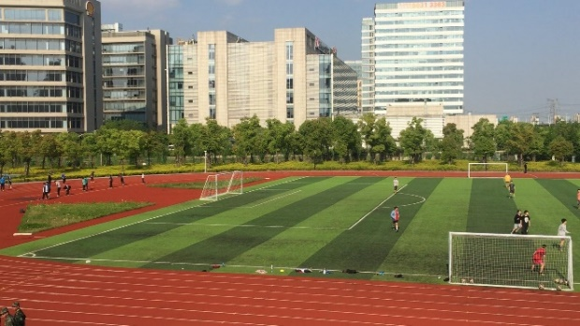
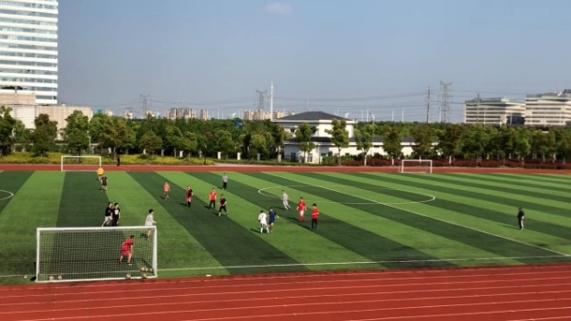
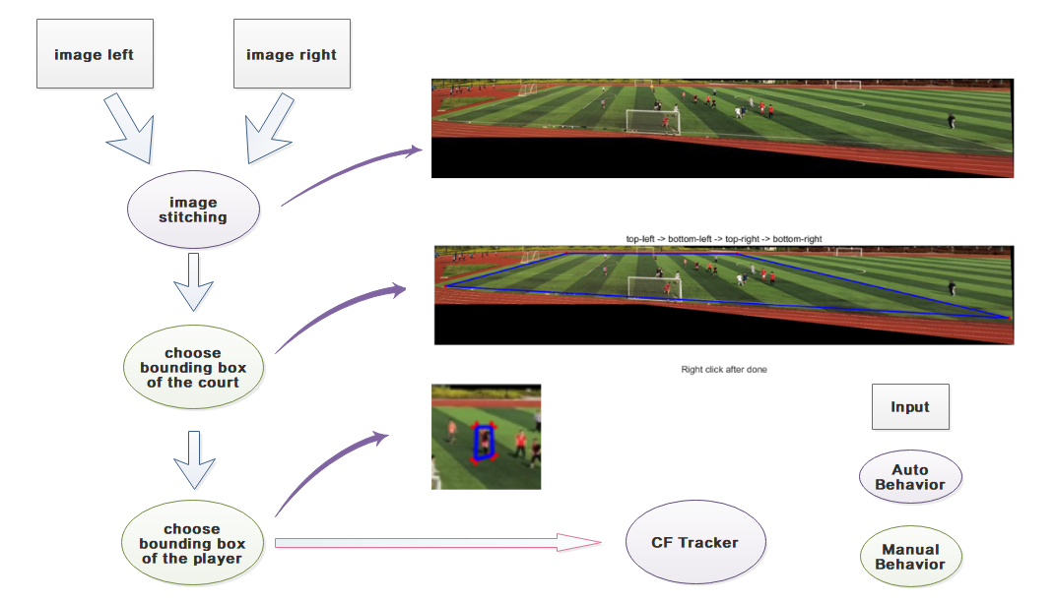
04
Framework

Slide 12
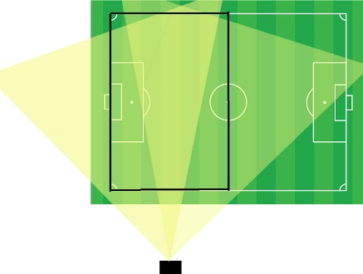
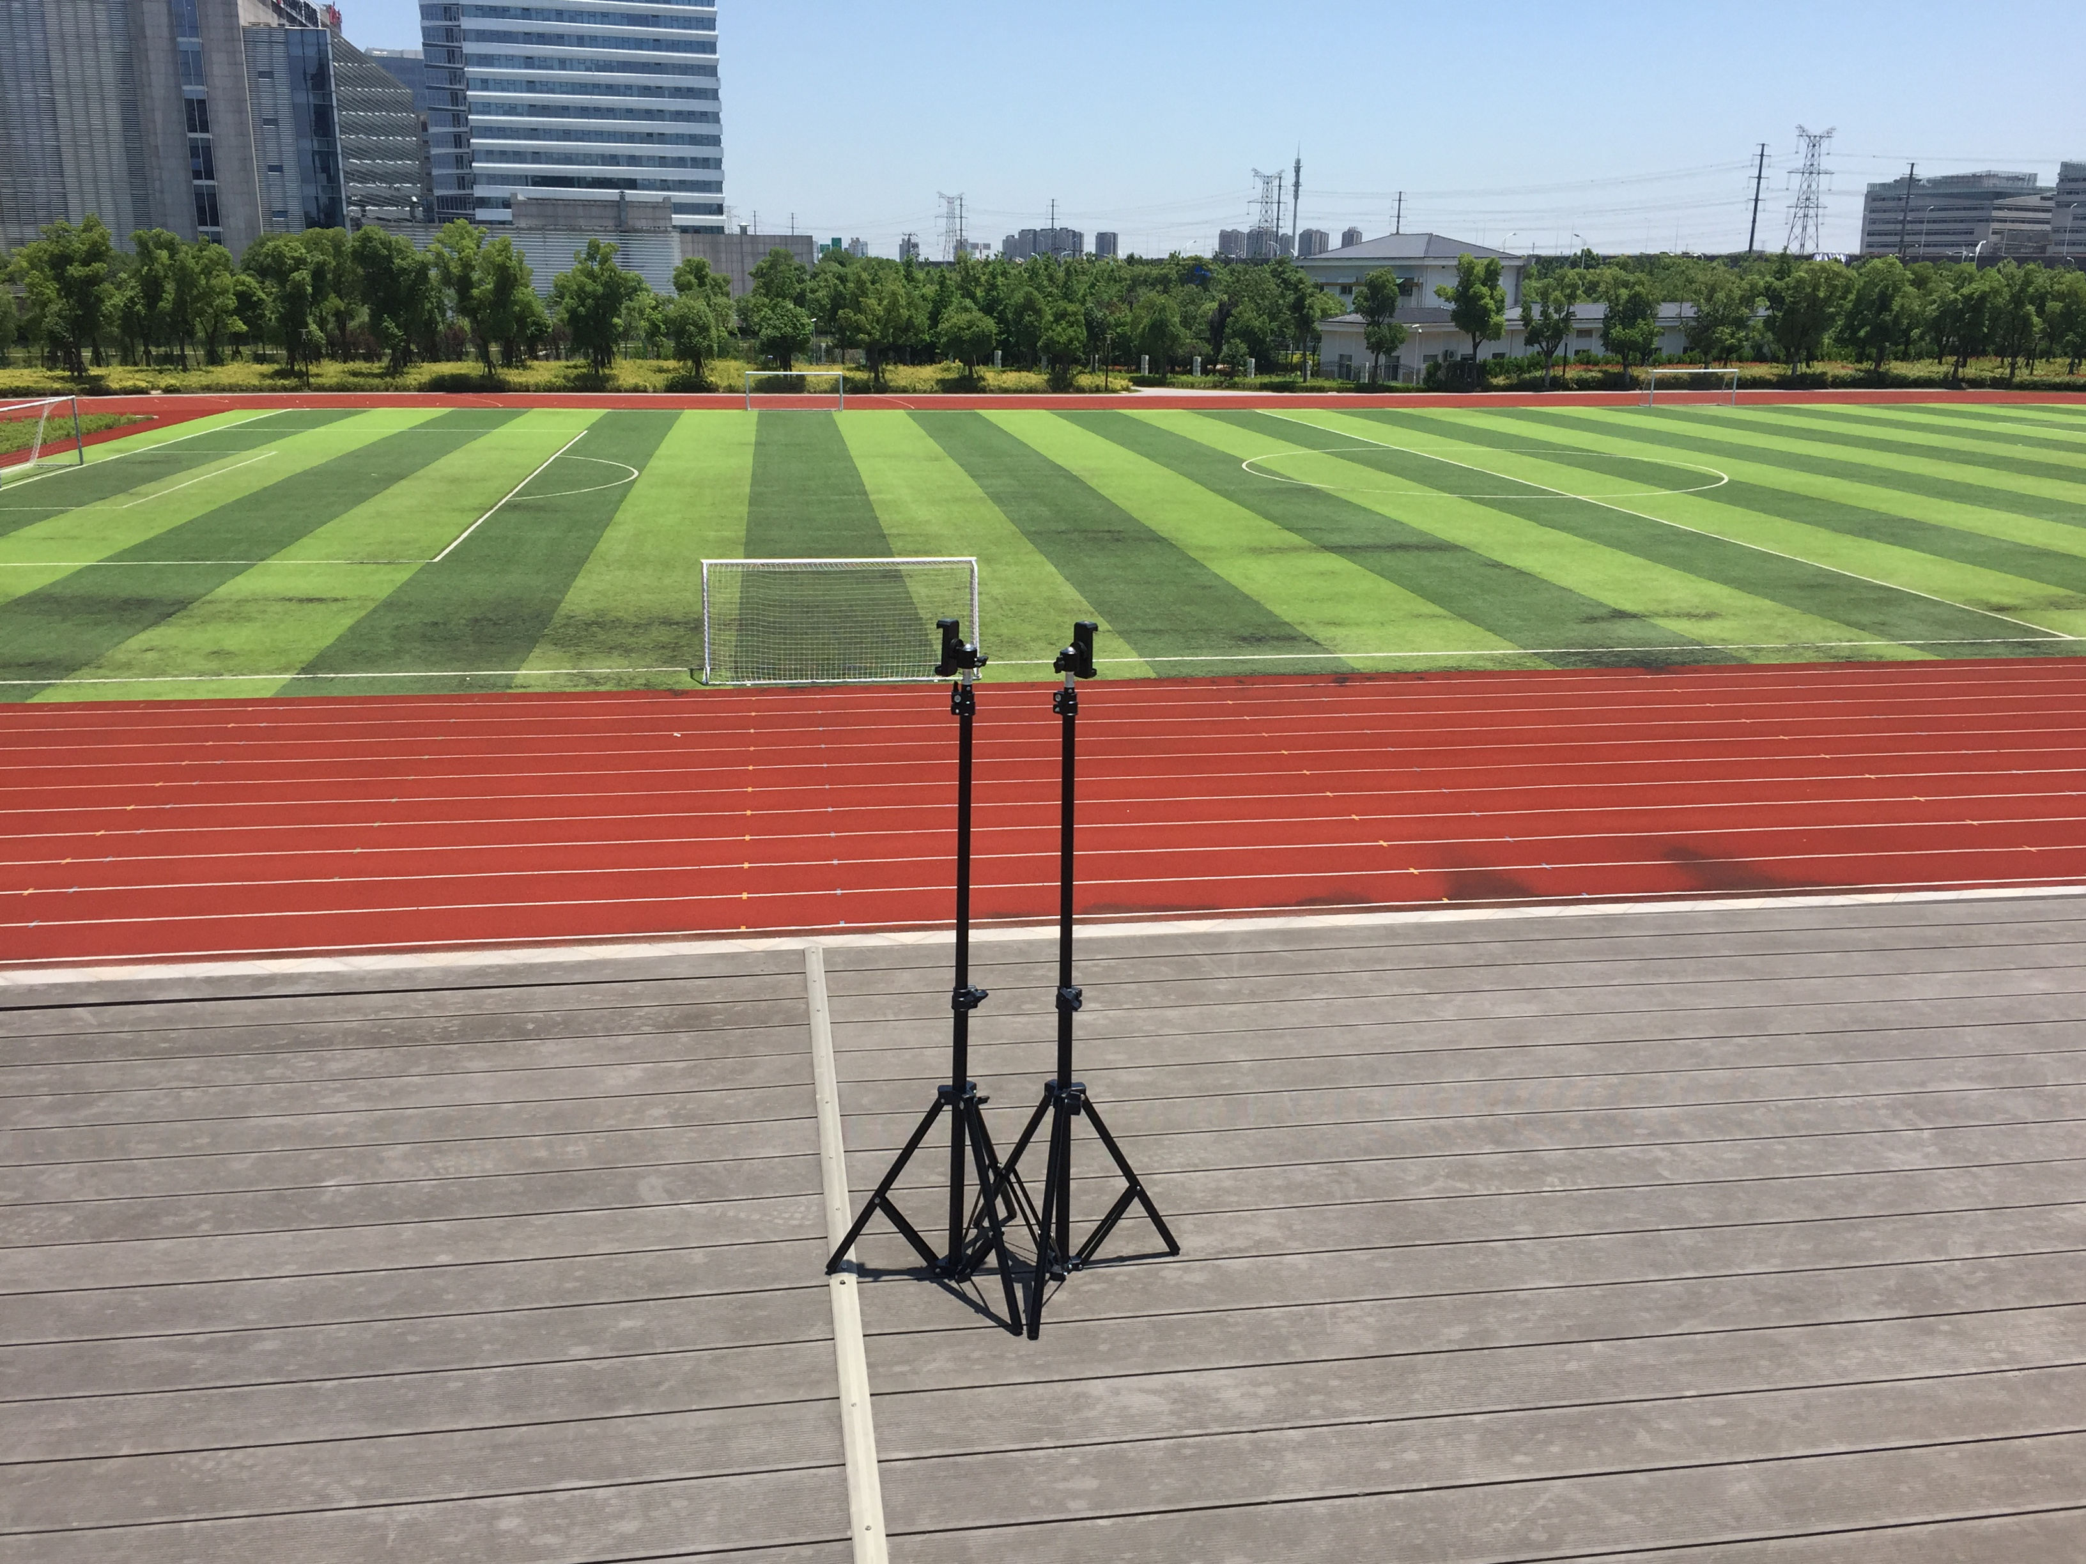
04
Framework-Image Stitching
4.1.1 Camera setup
Notes:
1920*1080 像素 30 fps iphone 拍摄 ，视野角度达到了73°

Slide 13
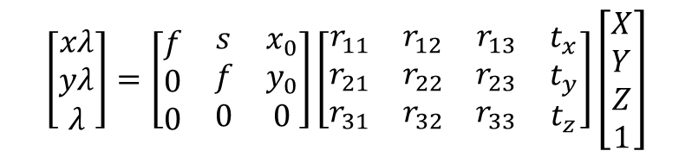
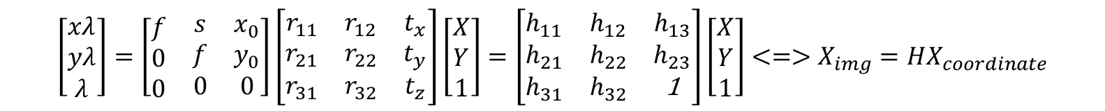
04
Framework-Image Stitching
4.1.2 Homography and Planar Panorama
$$\left[\begin{matrix}xλ \\ yλ \\ λ\end{matrix}\right]=\left[\begin{matrix}\begin{matrix}f \\ 0 \\ 0\end{matrix} & \begin{matrix}s \\ f \\ 0\end{matrix} & \begin{matrix}x_{0} \\ y_{0} \\ 0\end{matrix}\end{matrix}\right]\left[\begin{matrix}\begin{matrix}r_{11} \\ r_{21} \\ r_{31}\end{matrix} & \begin{matrix}r_{12} \\ r_{22} \\ r_{32}\end{matrix} & \begin{matrix}r_{13} \\ r_{23} \\ r_{33}\end{matrix} & \begin{matrix}t_{x} \\ t_{y} \\ t_{z}\end{matrix}\end{matrix}\right]\left[\begin{matrix}X \\ Y \\ Z \\ 1\end{matrix}\right]$$
Where the 3x3 matrix refers to the camera's intrinsic matrix and the 3x4 matrix is the extrinsic matrix.
A rotating camera around its axis of projection is equivalent to consider that the points are on a plane at infinity，thus the value of the z-axis of the world coordinate can be set to zero, then the new equation can be written as:
$$\left[\begin{matrix}xλ \\ yλ \\ λ\end{matrix}\right]=\left[\begin{matrix}\begin{matrix}f \\ 0 \\ 0\end{matrix} & \begin{matrix}s \\ f \\ 0\end{matrix} & \begin{matrix}x_{0} \\ y_{0} \\ 0\end{matrix}\end{matrix}\right]\left[\begin{matrix}r_{11} & r_{12} & t_{x} \\ r_{21} & r_{22} & t_{y} \\ r_{31} & r_{32} & t_{z}\end{matrix}\right]\left[\begin{matrix}X \\ Y \\ 1\end{matrix}\right]=\left[\begin{matrix}h_{11} & h_{12} & h_{13} \\ h_{21} & h_{22} & h_{23} \\ h_{31} & h_{32} & \text{1}\end{matrix}\right]\left[\begin{matrix}X \\ Y \\ 1\end{matrix}\right]<=>X_{img}=HX_{coordinate}$$

Slide 14
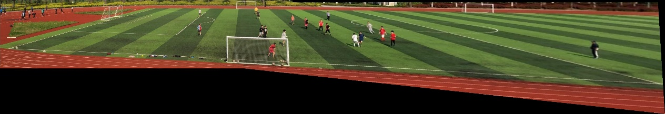
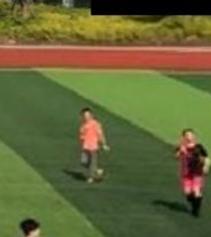
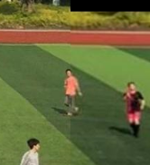
04
Framework-Image Stitching
4.1.3 RANSAC and Alpha Blending
With alpha blending
Without alpha blending

Slide 15
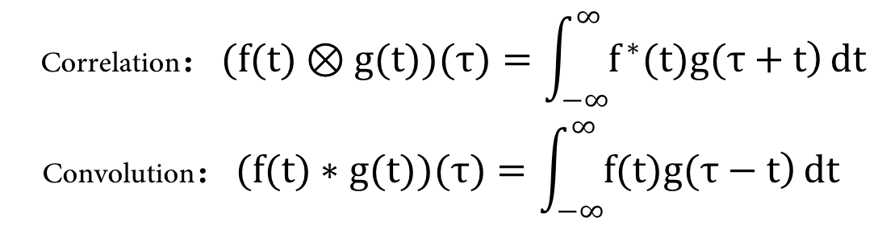
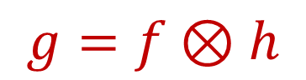
04
Framework-CF Tracker
4.2.1 Correlation filter
$$\begin{matrix} \text{C}\text{orrelation}：(f(t)⊗g(t))(τ)=\int_{−∞}^{∞}{\left.f^{∗}(t)g(τ+t\right)}dt \\ \text{C}\text{onvolution}：(f(t)∗g(t))(τ)=\int_{−∞}^{∞}{\left.f(t)g(τ−t\right)}dt\end{matrix}$$
Relation between correlation and convolution
$$\left(f(t)⊗g(t))(τ)=(f^{∗}(−t)∗g(t))(τ\right)$$
$$g=f⊗h$$

Slide 16
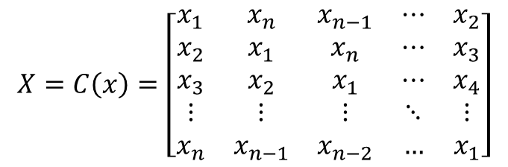
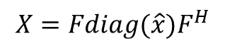
04
Framework-CF Tracker
4.2.2 Cyclic shifts
$$X=C\left(x\right)=\left[\begin{matrix}x_{1} & x_{n} & x_{n−1} & ⋯ & x_{2} \\ x_{2} & x_{1} & x_{n} & ⋯ & x_{3} \\ x_{3} & x_{2} & x_{1} & ⋯ & x_{4} \\ ⋮ & ⋮ & ⋮ & ⋱ & ⋮ \\ x_{n} & x_{n−1} & x_{n−2} & … & x_{1}\end{matrix}\right]$$
$$X=Fdiag(\hat{x})F^{H}$$

Slide 17

Results

Slide 18
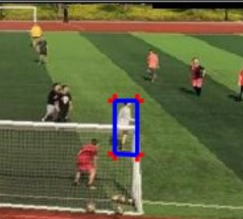
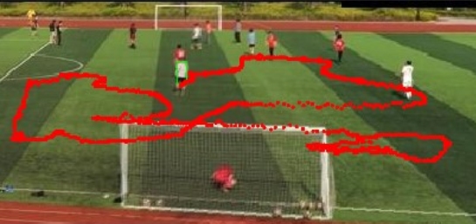
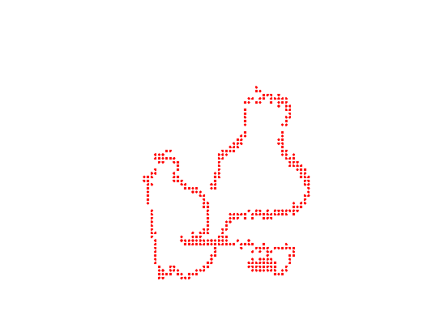
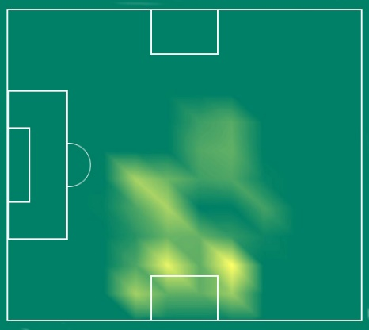
05
Results-Tracking
Notes:
左上角是追踪的第一帧
右上角是追踪过程的记录，我标注了bounding box 下边缘的中间点
左下角是我将图上的点 通过单应性矩阵 转换为了二维图，但无法表示密集程度
右下角就是我的最终效果，球员跑动的热度图。

Slide 19
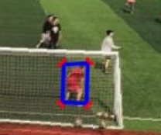
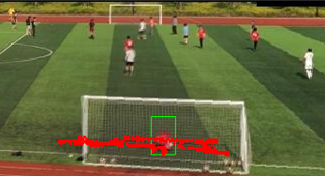
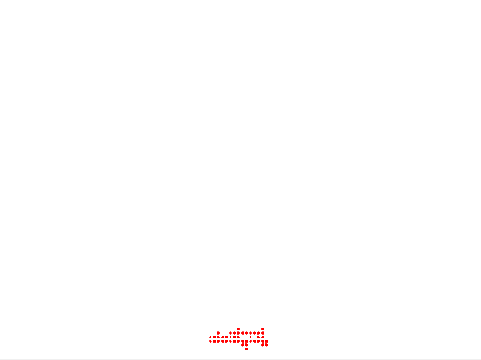
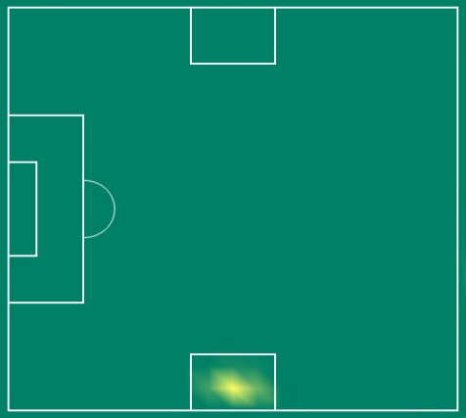
05
Results-Tracking

Slide 20
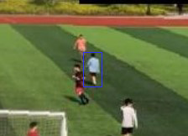
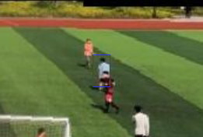
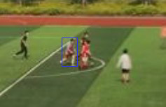
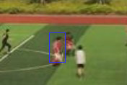
05
Results-Occlusion
Partial occlusion
Full occlusion
Notes:
我在KCF的基础上，基于最新论文 加入了背景信息，来使得滤波器更能分辨。

Slide 21
05
Results-Time
i7-4760HQ@2.10GHZ and MATLAB R2016B
For image stitching :
Resize the image from 1920x1080 to 225x960 pixels:
1.1 seconds per frame
For tracking :
1. Sample every 4 frames and take 250 seconds to deal with 1650 frames :
2. 24 fps

Slide 22

Further Works

Slide 23
06
Further Works
Multiple people tracking
Binocular stereo vision (depth )
Implementation in C/C++

Slide 24

THANKS!

